Slide 1
Methods of Proof

Slide 2
This Lecture
Now we have learnt the basics in logic.
We are going to apply the logical rules in proving mathematical theorems.
Direct proof
Contrapositive
Proof by contradiction
Proof by cases

Slide 3
Basic Definitions
An integer n is an even number
if there exists an integer k such that n = 2k.
An integer n is an odd number
if there exists an integer k such that n = 2k+1.

Slide 4




Proving an Implication
Goal: If P, then Q. (P implies Q)
Method 1: Write assume P, then show that Q logically follows.
Claim:
If
, then
Reasoning:
When x=0, it is true.
When x grows, 4x grows faster than x³ in that range.
Proof:
When

Slide 5
Direct Proofs
The sum of two even numbers is even.
Proof
x = 2m, y = 2n
x+y = 2m+2n
= 2(m+n)
The product of two odd numbers is odd.
Proof
x = 2m+1, y = 2n+1
xy = (2m+1)(2n+1)
= 4mn + 2m + 2n + 1
= 2(2mn+m+n) + 1.

Slide 6
Divisibility
a “divides” b (a|b):
b = ak for some integer k
5|15 because 15 = 35
n|0 because 0 = n0
1|n because n = 1n
n|n because n = n1
A number p > 1 with no positive integer divisors other than 1 and itself
is called a prime. Every other number greater than 1 is called composite.
2, 3, 5, 7, 11, and 13 are prime,
4, 6, 8, and 9 are composite.

Slide 7
Simple Divisibility Facts
1. If a | b, then a | bc for all c.
2. If a | b and b | c, then a | c.
3. If a | b and a | c, then a | sb + tc for all s and t.
4. For all c ≠ 0, a | b if and only if ca | cb.
Proof of (1)
a | b
b = ak
bc = ack
bc = a(ck)
a|bc
a “divides” b (a|b):
b = ak for some integer k

Slide 8
Simple Divisibility Facts
1. If a | b, then a | bc for all c.
2. If a | b and b | c, then a | c.
3. If a | b and a | c, then a | sb + tc for all s and t.
4. For all c ≠ 0, a | b if and only if ca | cb.
Proof of (2)
a | b => b = ak₁
b | c => c = bk₂
=> c = ak₁k₂
=> a|c
a “divides” b (a|b):
b = ak for some integer k

Slide 9
Simple Divisibility Facts
1. If a | b, then a | bc for all c.
2. If a | b and b | c, then a | c.
3. If a | b and a | c, then a | sb + tc for all s and t.
4. For all c ≠ 0, a | b if and only if ca | cb.
Proof of (3)
a | b => b = ak₁
a | c => c = ak₂
sb + tc
= sak₁ + tak₂
= a(sk₁ + tk₂)
=> a|(sb+tc)
a “divides” b (a|b):
b = ak for some integer k

Slide 10
This Lecture
Direct proof
Contrapositive
Proof by contradiction
Proof by cases

Slide 11
Proving an Implication
Goal: If P, then Q. (P implies Q)
Method 1: Write assume P, then show that Q logically follows.
Claim:
If r is irrational, then √r is irrational.
How to begin with?
What if I prove “If √r is rational, then r is rational”, is it equivalent?
Yes, this is equivalent;
proving “if P, then Q” is equivalent to proving “if not Q, then not P”.

Slide 12
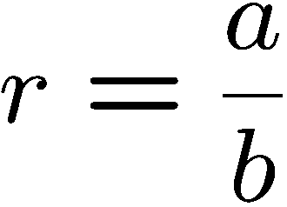
Rational Number
R is rational ⬄ there are integers a and b such that
numerator
and b ≠ 0.
denominator
Is 0.281 a rational number?
Is 0 a rational number?
If m and n are non-zero integers, is (m+n)/mn a rational number?
Is the sum of two rational numbers a rational number?
Yes, 281/1000
Yes, 0/1
Yes
Yes, a/b+c/d=(ad+bc)/bd

Slide 13
Is x=0.12121212…… a rational number?
Note that 100x-x=12, and so x=12/99.

Slide 14
Proving an Implication
Goal: If P, then Q. (P implies Q)
Method 2: Prove the contrapositive, i.e. prove “not Q implies not P”.
Claim:
If r is irrational, then √r is irrational.
Proof:
We shall prove the contrapositive –
“if √r is rational, then r is rational.”
Since √r is rational, √r = a/b for some integers a,b.
So r = a²/b². Since a,b are integers, a²,b² are integers.
Therefore, r is rational.
Q.E.D.
(Q.E.D.)
"which was to be demonstrated",
or “quite easily done”. ☺

Slide 15
Proving an “if and only if”
Goal: Prove that two statements P and Q are “logically equivalent”,
that is, one holds if and only if the other holds.
Example:
An integer is even if and only if the its square is even.
Method 1: Prove P implies Q and Q implies P.
Method 1’: Prove P implies Q and not P implies not Q.
Method 2: Construct a chain of if and only if statement.

Slide 16
Proof the Contrapositive
An integer is even if and only if its square is even.
Method 1: Prove P implies Q and Q implies P.
Statement: If m is even, then m² is even
Proof:
m = 2k
m² = 4k²
Statement: If m² is even, then m is even
Proof:
m² = 2k
m = √(2k)
??

Slide 17
Proof the Contrapositive
An integer is even if and only if its square is even.
Method 1’: Prove P implies Q and not P implies not Q.
Statement: If m² is even, then m is even
Contrapositive: If m is odd, then m² is odd.
Proof (the contrapositive):
Since m is an odd number, m = 2k+1 for some integer k.
So m² = (2k+1)²
= (2k)² + 2(2k) + 1
So m² is an odd number.

Slide 18
This Lecture
Direct proof
Contrapositive
Proof by contradiction
Proof by cases

Slide 19
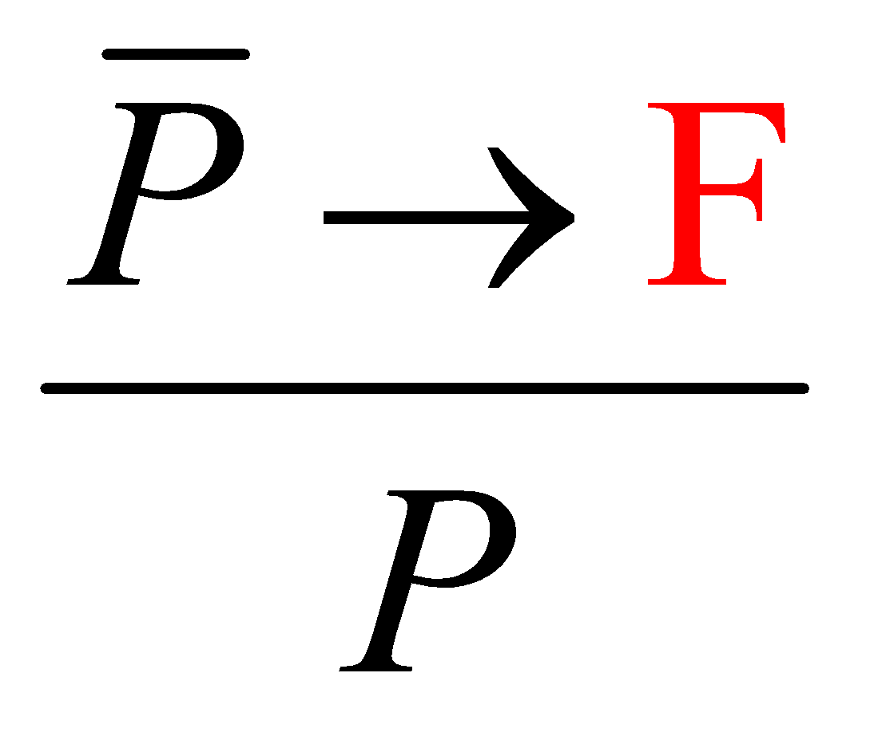

Proof by Contradiction
To prove P, you prove that not P would lead to ridiculous result,
and so P must be true.
You are working as a clerk.
If you have won the lottery, then you would not work as a clerk.
You have not won the lottery.

Slide 20
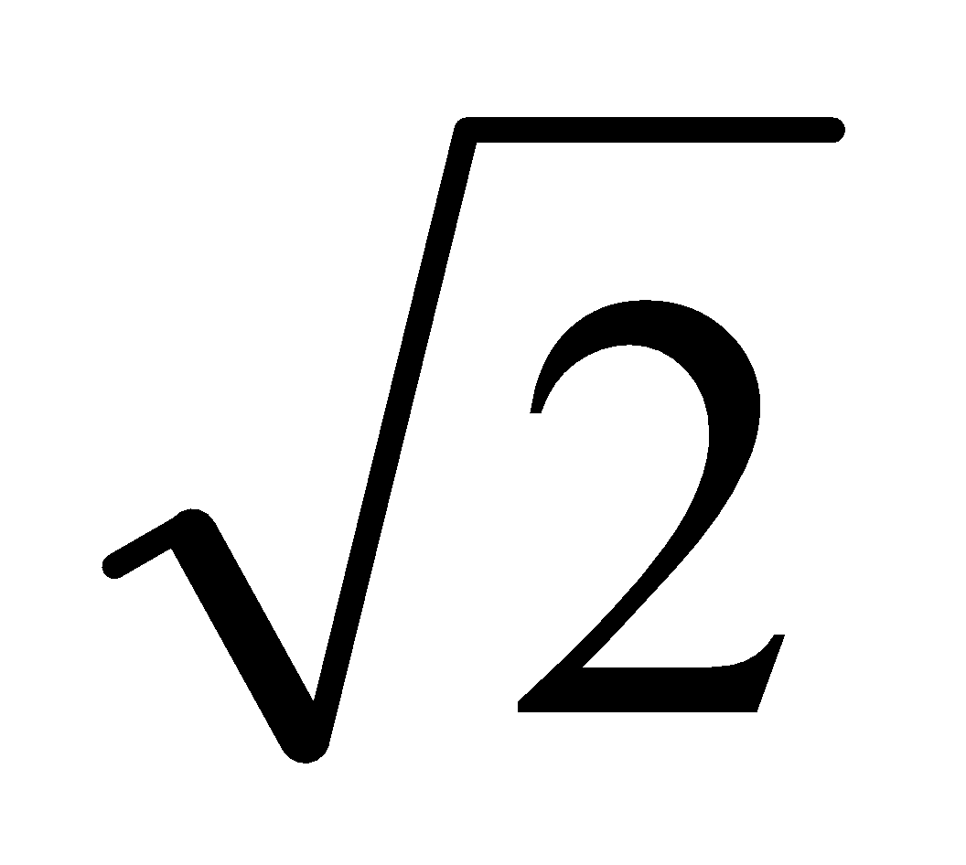
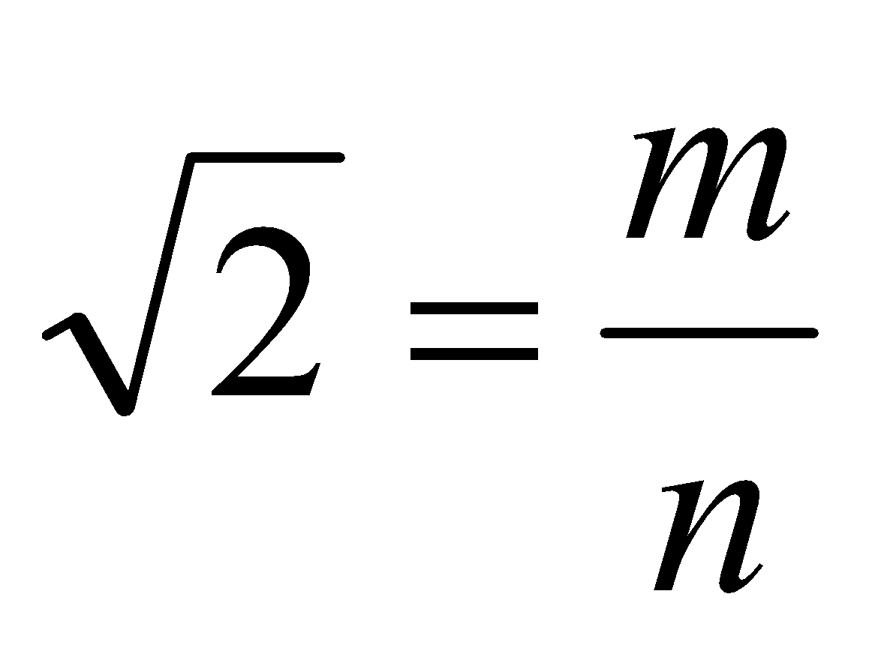
Proof by Contradiction
Theorem: is irrational.
Proof (by contradiction):
Suppose was rational.
Choose m, n integers without common prime factors (always possible) such that
Show that m and n are both even, thus having a common factor 2,
a contradiction!

Slide 21
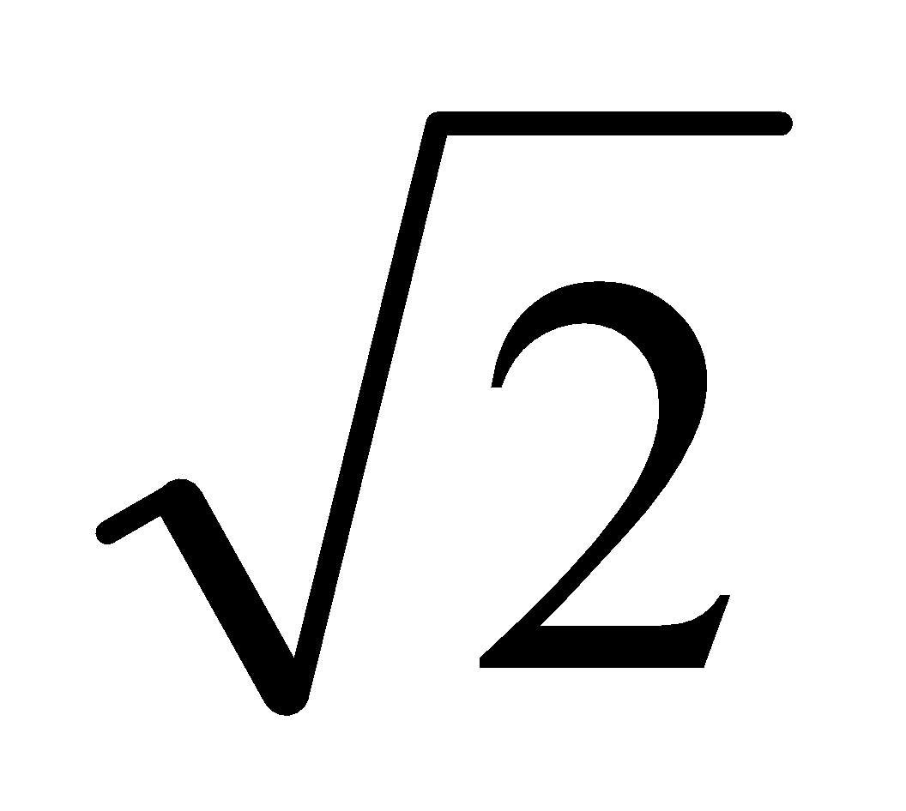
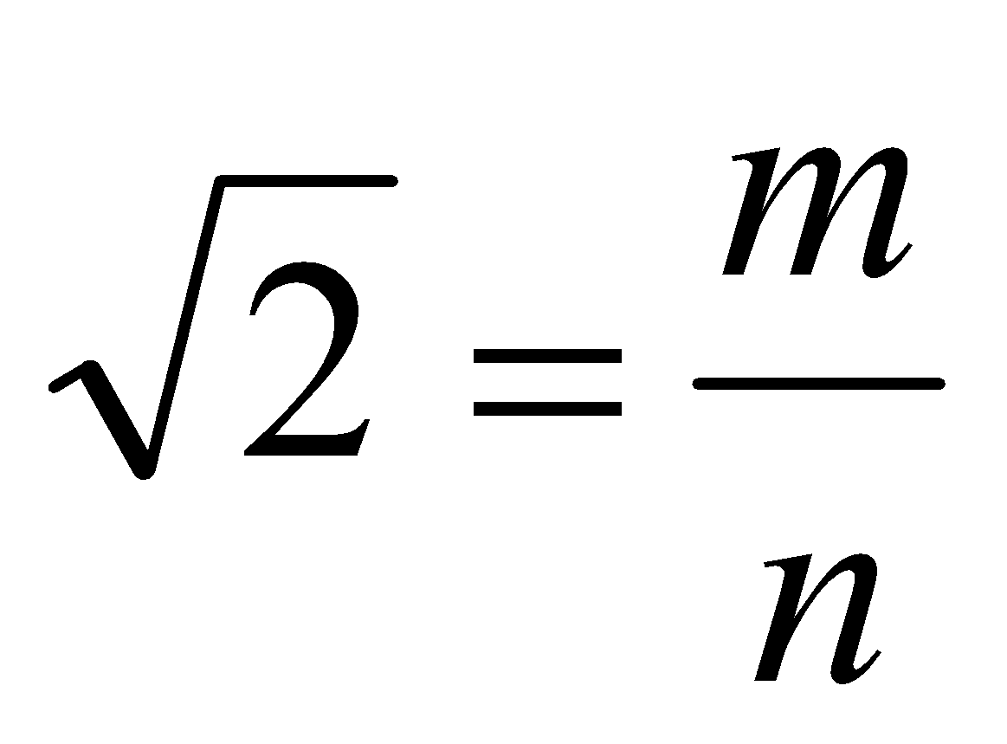
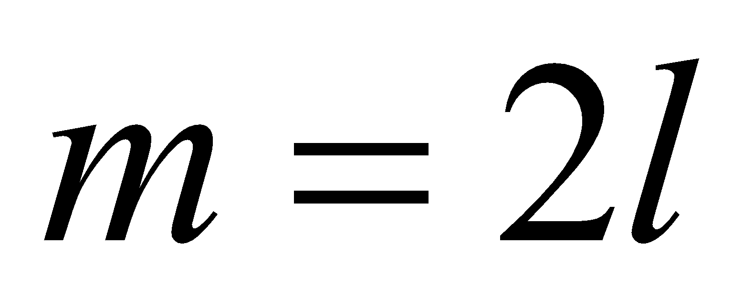
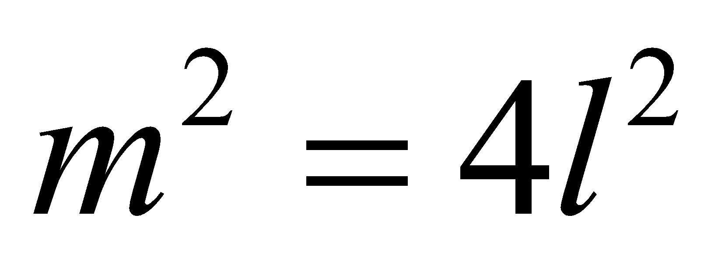
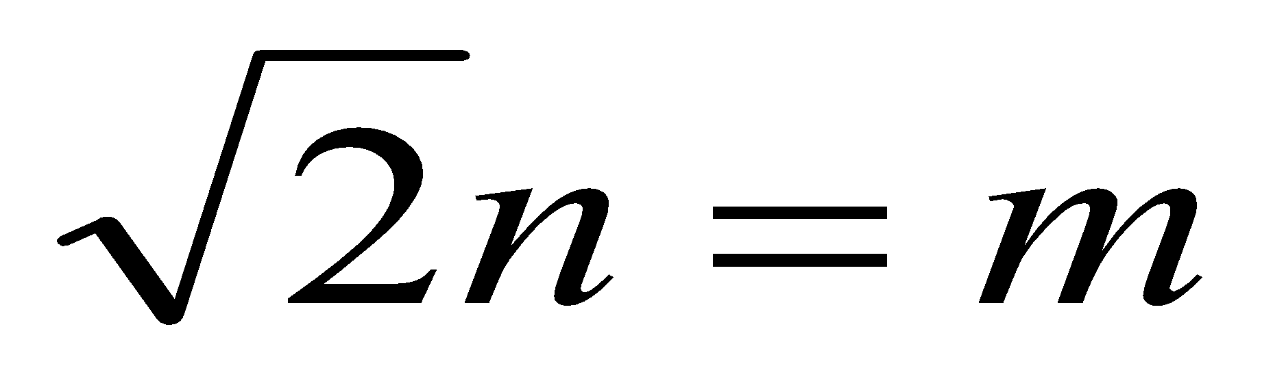
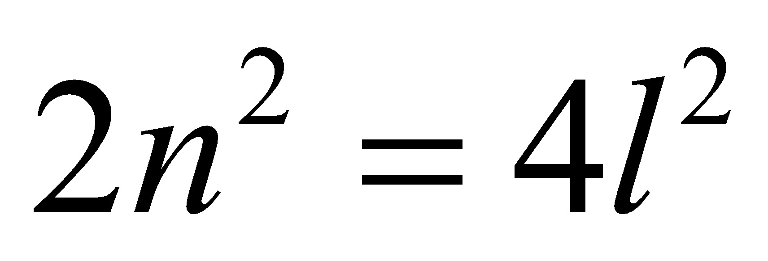
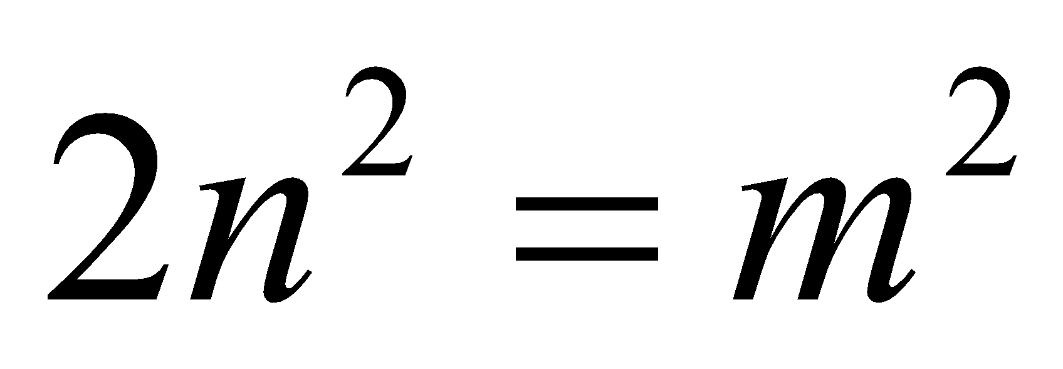
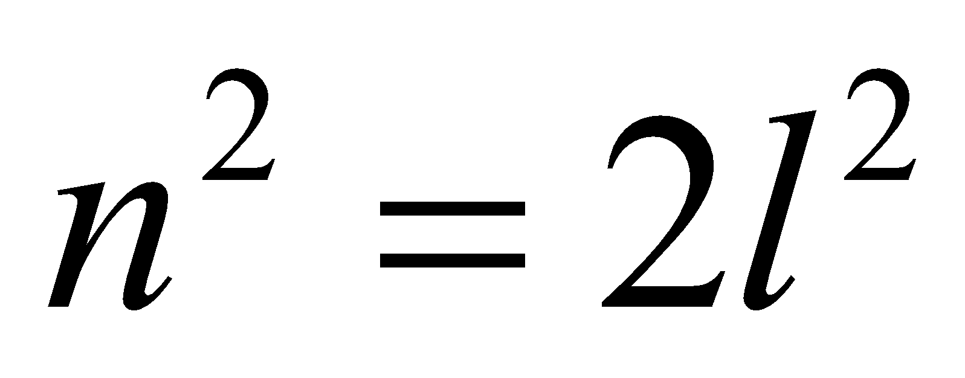
Proof by Contradiction
Theorem: is irrational.
Proof (by contradiction):
Want to prove both m and n are even.
so can assume
so m is even.
so n is even.

Slide 22
Infinitude of the Primes
Theorem. There are infinitely many prime numbers.
Proof (by contradiction):
Assume there are only finitely many primes.
Let p₁, p₂, …, p_{N} be all the primes.
We will construct a number N so that N is not divisible by any p_{i}.
By our assumption, it means that N is not divisible by any prime number.
On the other hand, we show that any number must be divisible by some prime.
It leads to a contradiction, and therefore the assumption must be false.
So there must be infinitely many primes.

Slide 23
Divisibility by a Prime
Theorem. Any integer n > 1 is divisible by a prime number.
Let n be an integer.
If n is a prime number, then we are done.
Otherwise, n = ab, both are smaller than n.
If a or b is a prime number, then we are done.
Otherwise, a = cd, both are smaller than a.
If c or d is a prime number, then we are done.
Otherwise, repeat this argument, since the numbers are
getting smaller and smaller, this will eventually stop and
we have found a prime factor of n.
Idea of induction.

Slide 24
Infinitude of the Primes
Theorem. There are infinitely many prime numbers.
Proof (by contradiction):
Let p₁, p₂, …, p_{N} be all the primes.
Consider p₁p₂…p_{N} + 1.
Claim: if p divides a, then p does not divide a+1.
Proof (by contradiction):
a = cp for some integer c
a+1 = dp for some integer d
=> 1 = (d-c)p, contradiction because p>=2.
So none of p₁, p₂, …, p_{N} can divide p₁p₂…p_{N} + 1, a contradiction.

Slide 25
This Lecture
Direct proof
Contrapositive
Proof by contradiction
Proof by cases

Slide 26




Proof by Cases
e.g. want to prove a nonzero number always has a positive square.
x is positive or x is negative
if x is positive, then x² > 0.
if x is negative, then x² > 0.
x² > 0.

Slide 27
The Square of an Odd Integer
Idea 0: find counterexample.
3² = 9 = 8+1, 5² = 25 = 3x8+1 …… 131² = 17161 = 2145x8 + 1, ………
Idea 1: prove that n² – 1 is divisible by 8.
n² – 1 = (n-1)(n+1) = ??…

Slide 28
Idea 2: consider (2k+1)²
(2k+1)²
= 4k²+4k+1
Any odd integer can be represented by 2k+1 for some integer k. (2k+1)²=4k²+2k+2k+1=4k²+4k+1=4k(k+1)+1.
k and (k+1) are consecutive integers, one of them has to be an even number, when an odd number is multiplied by an even number the result is always an even number.
Since k(k+1) is even it can be written in the form 2m for some integer m,
Now, 4k(k+1)+1=4(2m)+1=8m+1
Hence, the square of any odd integer can be written in the form (8m+1).

Slide 29


Trial and Error Won’t Work!
Fermat (1637): If an integer n is greater than 2,
then the equation a^{n} + b^{n} = c^{n} has no solutions in non-zero integers a, b, and c.
Claim:
has no solutions in non-zero integers a, b, and c.
False. But smallest counterexample has more than 1000 digits.
Euler conjecture:
has no solution for a,b,c,d positive integers.
Open for 218 years,
until Noam Elkies found

Slide 30
The Square Root of an Even Square
Statement: If m² is even, then m is even
Contrapositive: If m is odd, then m² is odd.
Proof (the contrapositive):
Since m is an odd number, m = 2l+1 for some natural number l.
So m² = (2l+1)²
= (2l)² + 2(2l) + 1
So m² is an odd number.
Proof by contrapositive.

Slide 31
Rational vs Irrational
Question: If a and b are irrational, can a^{b} be rational??
We know that √2 is irrational, what about √2^{√2} ?
Case 1: √2^{√2} is rational
Then we are done, a=√2, b=√2.
Case 2: √2^{√2} is irrational
Then (√2^{√2})^{√2} = √2² = 2, a rational number
So a=√2^{√2}, b= √2 will do.
So in either case there are a,b irrational and a^{b} be rational.
We don’t (need to) know which case is true!

Slide 32
Summary
We have learnt different techniques to prove mathematical statements.
Direct proof
Contrapositive
Proof by contradiction
Proof by cases
Next time we will focus on a very important technique, proof by induction.

